Slide 1
Pointer III: Array of Pointers & Pointer to 2D Array
<Adv C & App/>
Advanced C Programming
And It’s Application
Assistant Prof. Chan, Chun-Hsiang
Department of Artificial Intelligence, Tamkang University
Nov. 10, 2021
</ Adv C & App >

Slide 2
大綱
<Outline/>
[1] Recall: Pointer to Pointer
[2] Array of Pointers
[3] Pointer to Array
[4] Length of Array
[5] Summary of ptr2arr and arrOfptr
[6] 2D Array to Function
[7] Assignments
C
</Outline>

Slide 3
Pointer to Pointer
<ptr to ptr/>
「Pointer to Pointer」到底有甚麼應用呢?
如果我們要有一些列出矩陣的屬性資料(e.g., size, max, min, & sum)，我們要如何將這些屬性與這個矩陣做連結? 同時我們又希望可以把找屬性的這件事情，變成一個函數，每次使用時都直接進來呼叫，並得到我們要的結果。
這個時候「Pointer to Pointer」就很好用了!
max
min
sum
✽
✽
✽
int arr
4
2
1
8
6
7
</ptr to ptr>

Slide 4
Pointer to Pointer
<ptr to ptr/>
Find max value – return value
#include <stdio.h>
int myMax(int a[], int s){
int max = 0, i;
for (i=0;i<s;i++){
if (a[i]>max){
max = a[i];
}
}
return max;
}
int main(){
/*Ex 7-1: ptr2ptr :: find max in an array*/
printf("Ex 7-1: ptr2ptr :: find max in an array\n");
int arr[5] = {51,41,311,211,110};
int size = 5;
printf("%d\n",myMax(arr, size));
}
在不會pointer之前，如果要你尋找一個矩陣的最大值，你的找法應該是會這樣!
</ptr to ptr>

Slide 5
Pointer to Pointer
<ptr to ptr/>
Find max value – return a pointer
#include <stdio.h>
int *my_max(int a[], int s){
int *max = a, i;
for (i=0;i<s;i++){
if (a[i]>*max){
max = &a[i];
}
}
return max;
}
int main(){
/*Ex 7-2: ptr2ptr :: find max in an array*/
printf("Ex 7-2: ptr2ptr :: find max in an array\n");
int arr[5] = {51,41,311,211,110};
int size = 5;
printf("%d\n",*my_max(arr,size));
}
學過pointer之後你可以直接回傳pointer回來!
</ptr to ptr>

Slide 6
Pointer to Pointer
<ptr to ptr/>
Find max value – pointer to pointer
#include <stdio.h>
void my_max(int a[], int s, int **ptrmax){
*ptrmax = a;
int i;
for (i=0;i<s;i++){
if (a[i]>**ptrmax){
*ptrmax = &a[i];
}
}
}
int main(){
/*Ex 7-3: ptr2ptr :: find max in an array*/
printf("Ex 7-3: ptr2ptr :: find max in an array\n");
int arr[5] = {51,41,311,211,110};
int size = 5, *max;
my_max(arr, size, &max);
printf("max: %d\n",*max);
}
直接call矩陣回傳的是一個地址 ➔ 矩陣也是個pointer!
所以說可以用pointer to pointer指向一個矩陣變數arr!
</ptr to ptr>

Slide 7
Pointer to Pointer
<ptr to ptr/>
Lab 7-1:
請利用Ex 7-1 ~ 7-3的方式，實做出尋找最小值以及回傳最小值的位置(矩陣中的位置)。
測試資料:
int arr[10] = {5,7,9,3,4,0,6,1,2,8};
測試結果:
最小值為0，位置在第5個元素 (從0開始算)。
</ptr to ptr>

Slide 8
Array of Pointers
<arr of ptr/>
前面我們討論過如何利用指標來存取矩陣的屬性或一些特徵，那如果今天我想要將矩陣合併，或是將同資料型別的東西串起來，那應該如何去做呢?
int arr1[5] = {10,20,30,40,50};
int arr2[2] = {3,5};
int a = 5;
arr1
arr2
a
10 | 20 | 30 | 40 | 50 |  |  | 3 | 5 |  |  |  |  |  |  |  | 5
</arr of ptr>

Slide 9
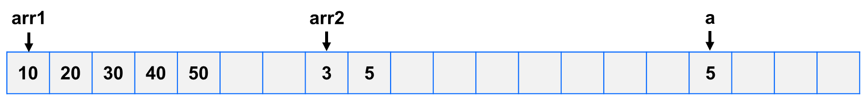
Array of Pointers
<arr of ptr/>
#include <stdio.h>
int main(){
/*Ex 7-4: array of pointers*/
printf("Ex 7-4: array of pointers\n");
int arr1[5] = {10, 20, 30, 40, 50};
int arr2[2] = {3,5};
int a = 5, i;
int *arrOfPtr[4] = {arr1, &a, arr1+3};
arrOfPtr[3] = arr2;
for (i=0; i<4; i++){
printf("%d\t%p\n", *arrOfPtr[i], arrOfPtr[i]);
}
}
</arr of ptr>

Slide 10
Array of Pointers
<arr of ptr/>
#include <stdio.h>
int main(){
/*Ex 7-5: array of pointers: print */
printf("Ex 7-5: array of pointers: print\n");
int arr1[10] = {10, 20, 30, 40, 50, 60, 70, 80, 90, 100}, arr2[5] = {11,12,13,14,15};
int arr3[3] = {111,112,113}, i, j;
int *arrOfPtr[3] = {arr1, arr2, arr3};
int s[3] = {10,5,3};
for (i=0; i<3; i++){
for (j=0; j<s[i]; j++){
printf("%d\t", arrOfPtr[i][j]);
}
printf("\n");
}
}
</arr of ptr>

Slide 11
Pointer to Array
<ptr to arr/>
在array of pointers之後，我們就是要來看到pointer to array，用pointer指向array。在開始之前，為了讓大家喚起記憶，我們先做以下簡短的小練習:
#include <stdio.h>
int main(){
int arr[4];
int *p = arr;
printf("p is %p, while p+1 is %p\n", p, p+1);
printf("&arr is %p, while &arr+1 is %p\n", &arr, &arr+1);
}
Lab 7-2:
思考這下列兩題的物理意義:
(1) (&p+1)-&p
(2) (&arr+1) - &arr
</ ptr to arr>

Slide 12
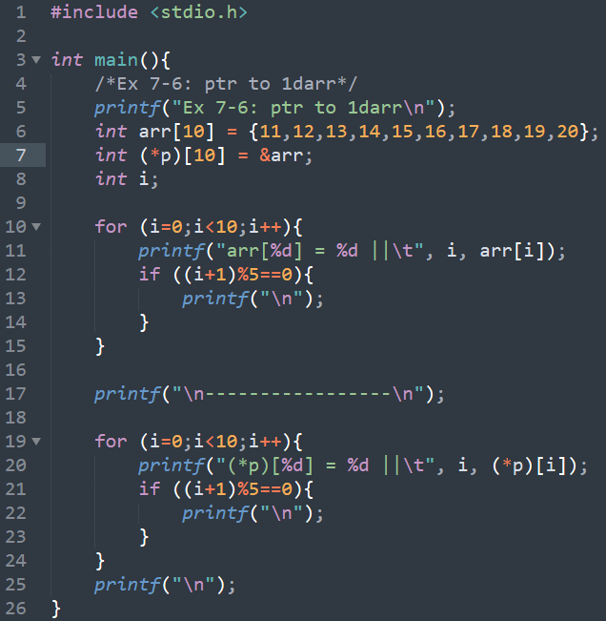
Pointer to Array
<ptr to arr/>
11 | 12 | 13 | 14 | 15 | 16 | 17 | 18 | 19 | 20
Note:
arr[i] ➔ int *
∴ an array is consisted of several pointers
s.t. we can use (*p)[10] to represent arr.
∵ an array in C has two characteristics:
“Array of pointers” to store all element locations
“Pointer to array” to indicate the first element of the array
</ ptr to arr>

Slide 13
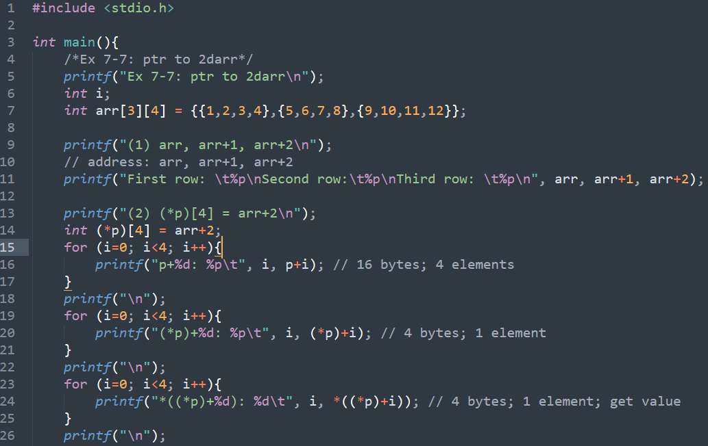
Pointer to Array
<ptr to arr/>
1 | 2 | 3 | 4 | 5 | 6 | 7 | 8 | 9 | 10 | 11 | 12
</ ptr to arr>

Slide 14
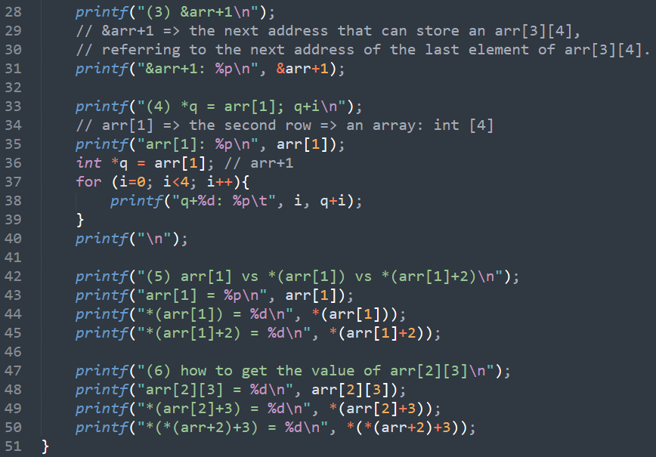
Pointer to Array
<ptr to arr/>
1 | 2 | 3 | 4 | 5 | 6 | 7 | 8 | 9 | 10 | 11 | 12
</ ptr to arr>

Slide 15
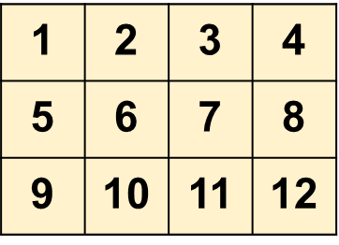
Pointer to Array
<ptr to arr/>
前面提過array擁有兩個特性:
Pointer to array
Array of pointers
也因為如此，不同表示式代表著不同的意義…
以Ex 7-7 為例，int arr[3][4] =
Expression | Type
arr | ???
arr+0 | ???
arr+2 | ???
arr[1] | ???
arr[1]+1 | ???
arr[2][3] | ???
</ ptr to arr>

Slide 16
Pointer to Array
<ptr to arr/>
Lab 7-3:
思考一下! *(arr[1]+3) ≡ *(*(arr+1)+3)?
以Ex 7-7 為例，int arr[3][4] = =
1 | 2 | 3 | 4 | 5 | 6 | 7 | 8 | 9 | 10 | 11 | 12
Expression | Type
arr | int [3][4]
arr+0 | int (*)[4]
arr+2 | int (*)[4]
arr[1] | int [4]
arr[1]+1 | int *
arr[2][3] | int
</ ptr to arr>

Slide 17
Pointer to Array
<ptr to arr/>
Lab 7-4:
依照上一頁的做法，完成下表:
int arr[3][4] =
Expression | Type | Explanation
(1) arr +1
(2) *(arr + 1)
(3) arr[2]
(4) arr[2]+1
(5) *(arr[2]+1)
(6) *(*(arr+1)+1)
(7) arr[1]+0
=
1 | 2 | 3 | 4 | 5 | 6 | 7 | 8 | 9 | 10 | 11 | 12
</ ptr to arr>

Slide 18
Length of Array
<len of arr/>
我們知道矩陣也是一個指標的時候，假設我今天對某個矩陣做了很多運算，然而我忘記剛剛在哪裡宣告這個矩陣，但是我想知道它的長度時該怎麼做?
int arr[5] = {4,7,5,8,1};
設計一個方法可以計算出來arr的長度!
Lab 7-5:
思考下列程式碼的回傳值?
arr
arr[1]
arr+1
&arr
&arr + 1
61FE10
int arr[5]
4
7
5
8
1
3
</len of arr>

Slide 19
Length of Array
<len of arr/>
作法一: 利用內建函數sizeof()
#include <stdio.h>
int main(){
/*Ex 7-8: length of array :: sizeof()*/
printf("Ex 7-8: length of array :: sizeof()\n");
int arr[4] = {10, 20, 30, 40};
printf(" length = %d\n", sizeof(arr)/sizeof(arr[0]));
}
</len of arr>

Slide 20
Length of Array
<len of arr/>
作法二: 利用矩陣的記憶體位置
#include <stdio.h>
int main(){
/*Ex 7-9: length of array :: address*/
printf("Ex 7-9: length of array :: address\n");
int arr[4] = {10, 20, 30, 40};
printf("arr: %p\n", arr); // int (*)[4]
printf("arr+1: %p\n", arr+1); // int *
printf("&arr+1: %p\n", &arr+1); // int (*)[4]
printf("*(&arr+1): %p\n", *(&arr+1)); // int *
printf("length = *(&arr+1)-arr: %d\n", *(&arr+1)-arr);
}
*(arr+1) = arr[1]
&arr
&arr+1
10 | 20 | 30 | 40
</len of arr>

Slide 21
Length of Array
<len of arr/>
*(arr+1) = arr[1] = *(p+1)
= *(*q+1) = *(q[0]+1) = q[0][1]
作法三: 利用矩陣的指標
#include <stdio.h>
int main(){
/*Ex 7-10: length of array :: pointer*/
printf("Ex 7-10: length of array :: pointer\n");
int arr[4] = {10, 20, 30, 40};
int *p = arr;
printf("p : %p\n", p); // int *
printf("p+1: %p\n", p+1); // int *
int (*q)[4] = &arr;
printf("q : %p\n", *q); // int *
printf("q+1: %p\n", *(q+1)); // int *
printf("length = *(q+1)-*(q+0): %d\n", *(q+1)-*(q+0));
}
&arr = q
&arr+1 = q+1
10 | 20 | 30 | 40
arr+1 = p+1 = *q+1 = q[0]+1
</len of arr>

Slide 22
Summary of ptr2arr and arrOfptr
<summary/>
int arr[4] = {11, 22, 33, 44};
int (*ptr2arr)[4] = &arr;
int *arrOfptr[4];
arrOfptr[0] = arr;
(6)
ptr2arr
(4)
11 | 22 | 33 | 44
33
(3)
Expression | Type
(1) ptr2arr | int (*)[4]
(2) ptr2arr+0 | int (*)[4]
(3) ptr2arr+1 | int (*)[4]
(4) ptr2arr[0] | int [4]
(5) ptr2arr[0]+2 | int *
(6) ptr2arr[0][2] | int
(1) & (2)
(5)
arrOfptr
</summary>

Slide 23
Summary of ptr2arr and arrOfptr
<summary/>
int arr[4] = {11, 22, 33, 44};
int (*ptr2arr)[4] = &arr;
int *arrOfptr[4];
arrOfptr[0] = arr;
ptr2arr
(5)
33
11 | 22 | 33 | 44
Expression | Type
arrOfptr | int *[4]
(2) arrOfptr+0 | int **
(3) arrOfptr+1 | int **
(4) arrOfptr[0] | int *
(5) arrOfptr[0]+2 | int *
(6) arrOfptr[0][2] | int
(6)
(4)
(2)
(3)
(1)
arrOfptr
</summary>

Slide 24
2D array passing into Functions
<2Darr to func/>
在我們目前學到靜態宣告矩陣的情況下，一但我們知道矩陣維度、大小、還有第0個元素的位置，其實我們就可以很容易在其他函數中，找到它並針對它做運算。
#include <stdio.h>
void print2Darr(int (*p)[4], int row){
// int (*p)[4] => change to other expressions...
int i, j;
for (i=0;i<row;i++){
for (j=0;j<4;j++){
printf("%d\t", p[i][j]); // change here!
}
printf("\n");
}
}
int main(){
/*Ex 7-13: 2D arr passing to func*/
printf("Ex 7-13: 2D arr passing to func\n");
int arr[3][4] = {{1,2,3,4},{5,6,7,8},{9,10,11,12}};
print2Darr(arr, 3);
}
Lab 7-6:
嘗試將Ex 7-13的兩處修改成其它的表示方式(每處至少寫兩種)，但不會改變其輸出的結果!
</2Darr to func>

Slide 25
作業一
<Assignments/>
假設我們今天有一個氣象資料，它每小時會有一筆紀錄陽明山測站的氣壓、氣溫、濕度、降雨量資料，如下表所示:
請將此資料利用一個函數(printWeatherInfo(double arg1, int arg2))將氣象紀錄印出，且arg1以及arg2其中一個必須為指標。
Time | 1 | 2 | 3 | 4 | 5 | 6 | 7 | 8 | 9
Pressure | 992.1 | 991.7 | 992.0 | 993.0 | 992.1 | 992.2 | 992.3 | 992.4 | 992.5
Temperature | 20.1 | 20.2 | 20.3 | 20.1 | 20.1 | 20.2 | 20.3 | 20.3 | 20.4
Humidity | 70.0 | 68.2 | 68.0 | 64.0 | 64.3 | 64.0 | 60.1 | 55.1 | 52.0
Rainfall | 10.0 | 5.0 | 1.0 | 0.0 | 0.0 | 0.0 | 0.0 | 0.0 | 0.0
</Assignments>

Slide 26
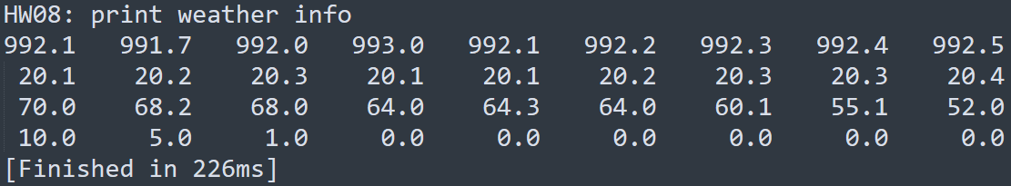
作業一
<Assignments/>
範例解答:
</Assignments>

Slide 27
References
<Refs/>
How to Build an Array of Pointers in C Programming: https://www.dummies.com/programming/c/how-to-build-an-array-of-pointers-in-c-programming/
Array of Pointers in C: https://overiq.com/c-programming-101/array-of-pointers-in-c/
Pointer to an Array in C https://www.tutorialspoint.com/cprogramming/c_pointer_to_an_array.htm
(C) 簡單搞懂指標(pointer)、指標陣列(pointers of array, int *foo[]) 與指向陣列的指標 (pointer to array, int (*bar)[]) http://hackgrass.blogspot.com/2018/03/c-pointerint-foo-int-bar.html
蔣宗哲教授 – 程式設計(一) 講義
</Refs>

